Slide 1
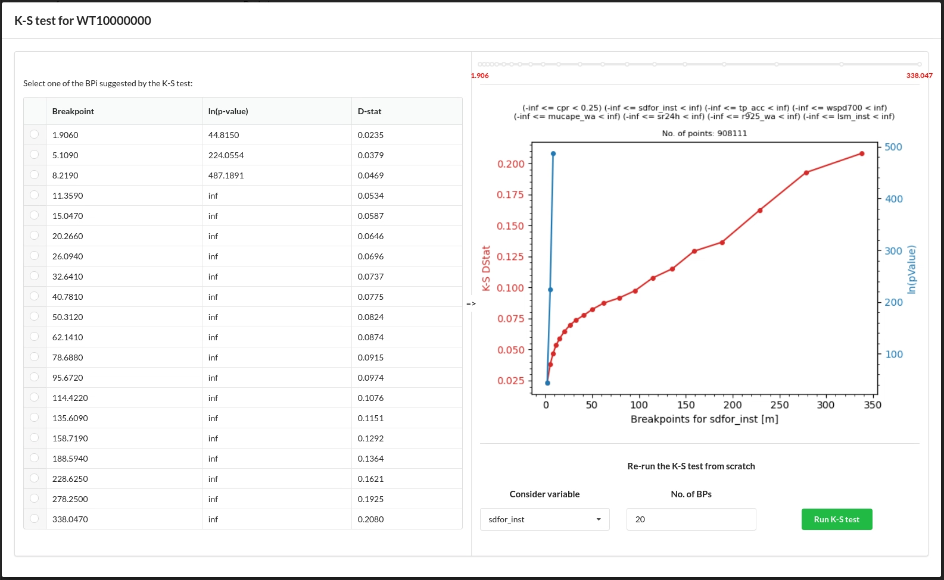
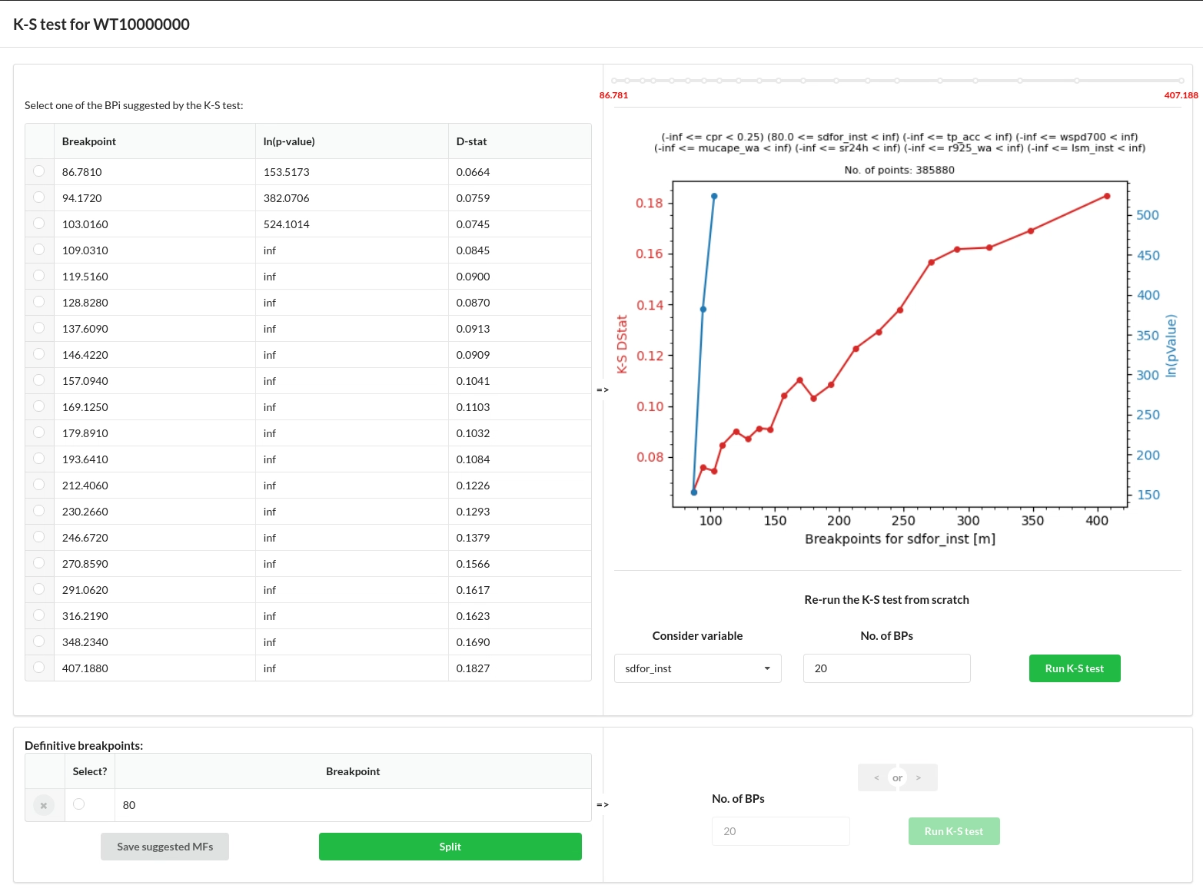
The k-Stest is stating that all BP produce significantly different distributions. To decide which BP to chose, let see the diagram on the right.
It is likely that there might not be significant differences in the MF up for sdfor<80 (area inside the orange circle).

Slide 2
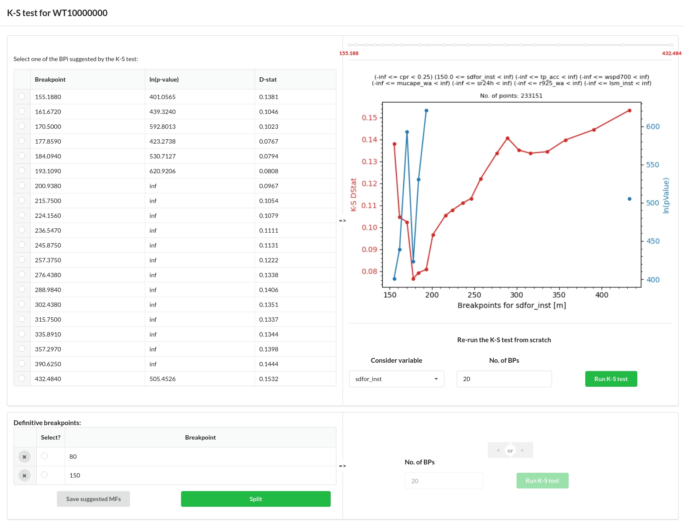
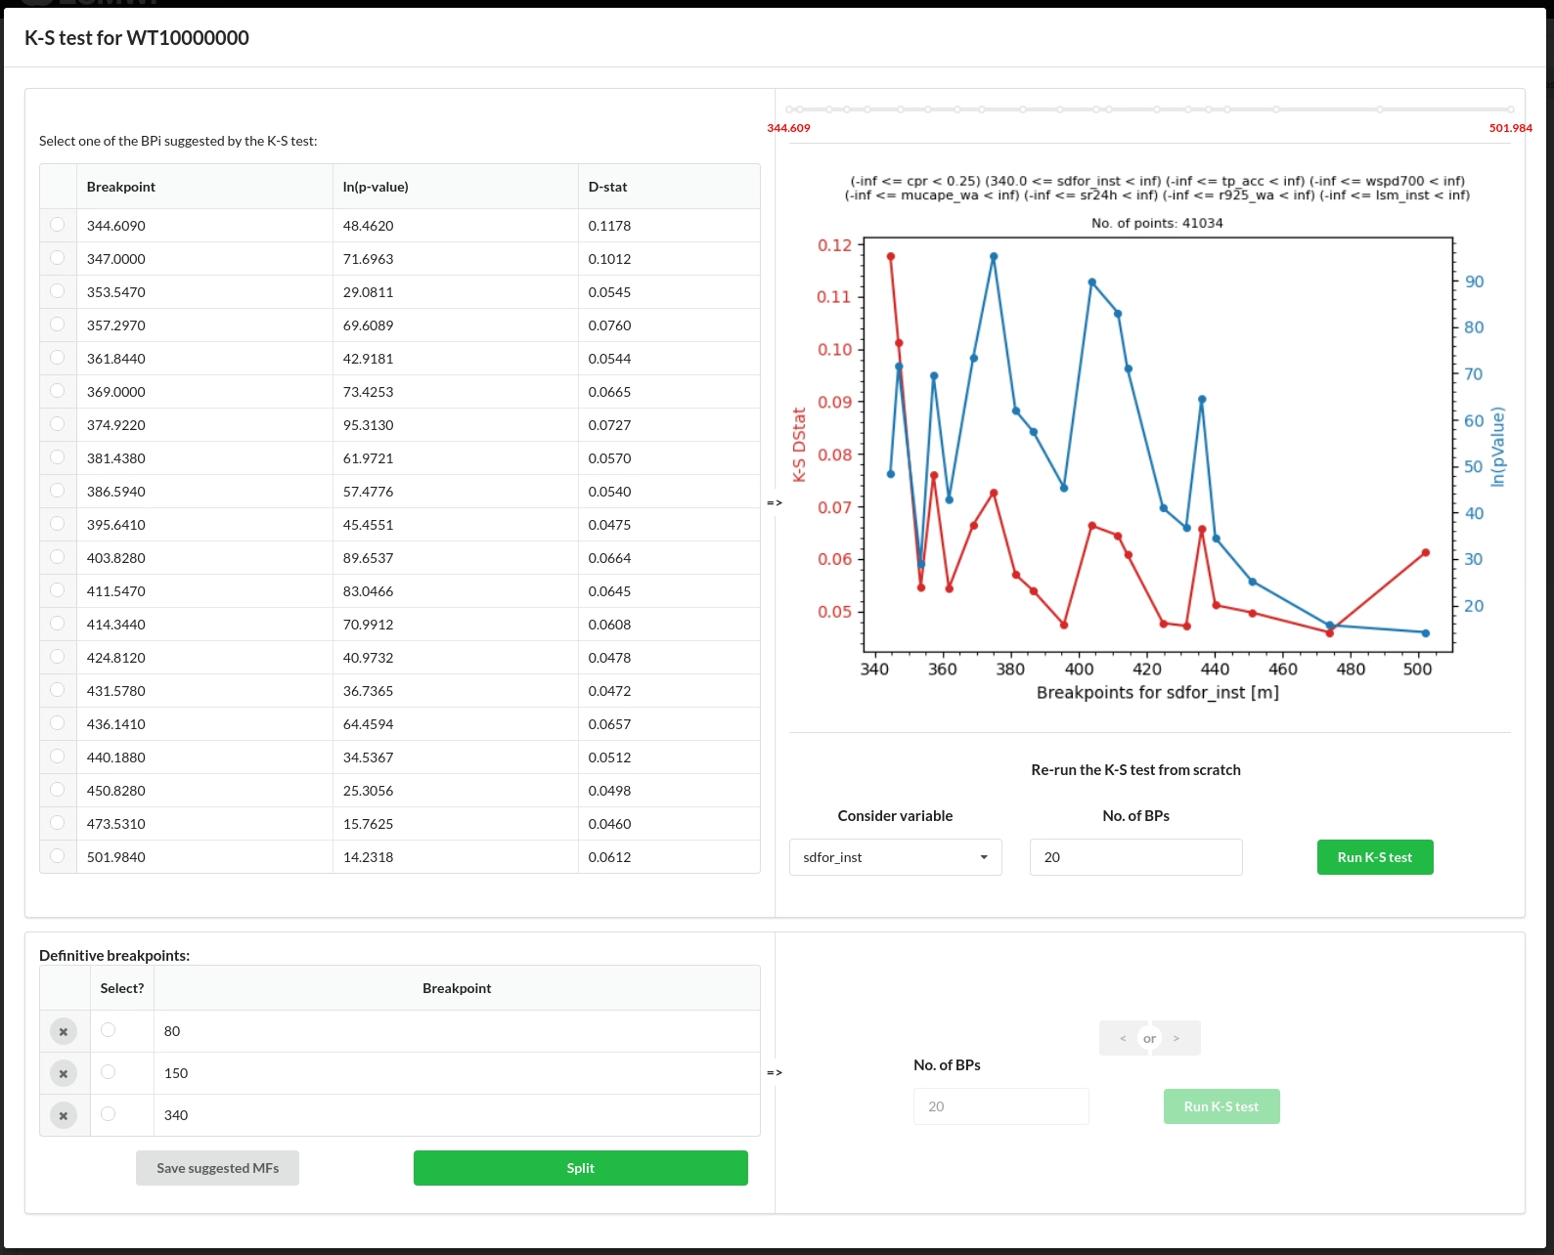
Non more significant differences are found, so no more BP are introduced.

Slide 3

